Slide 1
Atkinson Cycle Engines
Jacob Reagan

Slide 2
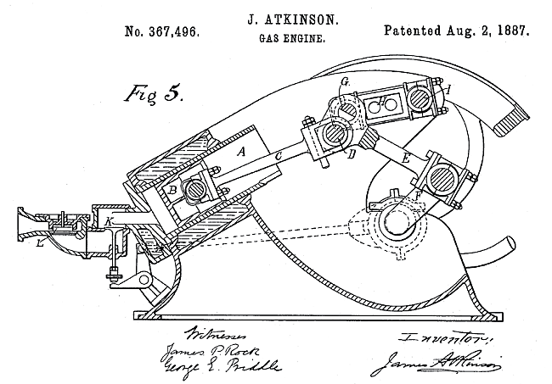
Brief History
Invented in 1882 by British engineer James Atkinson
Patents for the existing Otto-cycle engine presented a need for a new crankshaft design
Between 1886 and 1893 the British Gas Company built over 1000 Atkinson-cycle engines
Figure 1: The Atkinson Cycle engine patent: 1887 [1]

Slide 3
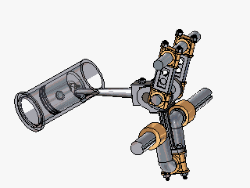
Atkinson-Cycle Engines
Operates on a four-stroke cycle
Intake, compression, combustion, and exhaust strokes occur in a one revolution of crankshaft
Combustion stroke is longer than compression stroke allowing more expansion of combustion gases
Greater efficiency when compared to Otto engines
Figure 2: The Atkinson Cycle Engine [1]

Slide 4
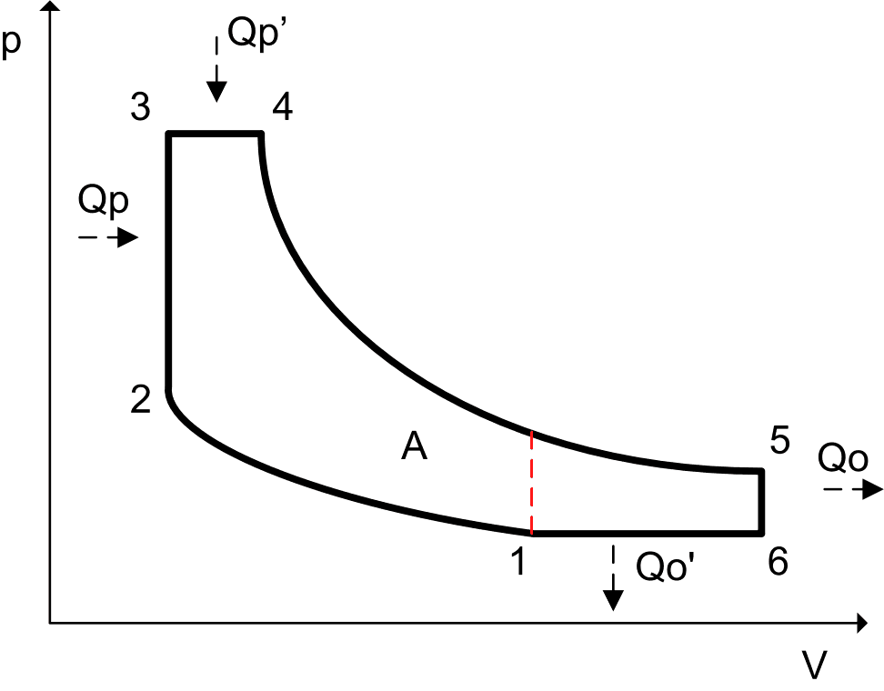
Thermodynamics of Atkinson-Cycle Engine
1. Reversible adiabatic compression
2. Heat addition at constant volume
3. Isentropic expansion
4. Heat rejection at constant pressure
Figure 3: The Atkinson Cycle P-v Diagram [2]

Slide 5
Atkinson-Cycle Engines Continued
Biggest disadvantage is reduction in power density (power/unit volume) arising from the reduction in air intake
Atkinson cycle engine can be supplemented with electric motor to provide more power if needed
Electric motors can be used in combination or independent of Atkinson cycle engines to provide the desired power output most efficiently

Slide 6

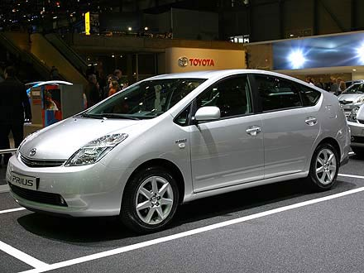

Atkinson-Cycle Engines Today

Slide 7
Questions?

Slide 8
Sources
[1] Unusual Internal-Combustion Engines, “The Atkinson Cycle Engine”, (Electronic Database), (Cited 10-28-09) http://www.dself.dsl.pipex.com/MUSEUM/POW ER/unusualICeng/atkin son/ atkinson.htm
[2] Wikipedia, “Atkinson Cycle”, (Electronic Database), (Cited 10-28-09) http://en.wikipedia.org/wiki/Atkinson_cycle

